Slide 1
Using Set Language in Probability

Slide 2
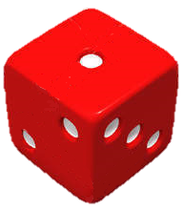

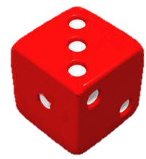
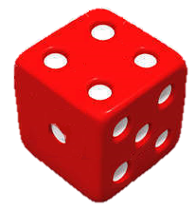
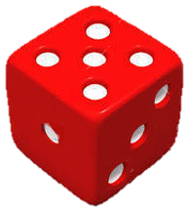
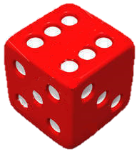
Sample Spaces and Events
In throwing a fair dice once:
The 6 possible outcomes are:
All these outcomes form a sample space.
If we denote the sample space by S, then
S = {1, 2, 3, 4, 5, 6}
S corresponds to the universal set U and n(S) = 6.

Slide 3

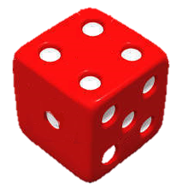
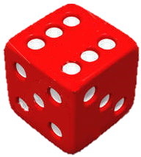


Sample Spaces and Events
In throwing a fair dice once:
Consider the event of getting an even number.
The 3 favourable outcomes are:
If we denote the event of getting an even number by E, then
E = {2, 4, 6}
2, 4, 6 are the favourable outcomes and n(E) = 3.

Slide 4
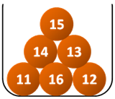
Follow-up question
An urn contains 6 balls numbered from 11 to 16 respectively. A ball is drawn from the urn.
(a) Write down the sample space S.
(b) Use set notations to represent each of the following events.
(i) Event X: The number on the ball is even.
(ii) Event Y: The number on the ball is a prime number.
(a) S = {11, 12, 13, 14, 15, 16}
(b) (i) X = {12, 14, 16}
(ii) Y = {11, 13}

Slide 5

Let us consider the event E of getting an even number in throwing a fair dice once again.
Do you remember how to find the probability of the event E?
In general, if all the possible outcomes concerned are equally likely to occur, the probability P(E) of an event E is defined as:
P(E) =
number of outcomes favourable to event E
total number of possible outcomes

Slide 6









The 6 possible outcomes in throwing a fair dice once are:
The 3 favourable outcomes of getting an even number are:
As all the possible outcomes are equally likely to occur,
the probability of event E is given by
P(E)
No. of favourable outcomes
Total no. of possible outcomes

Slide 7
In set notations, we have
P(E) = =
number of elements in E
n(E)
number of elements in S
n(S)
S is the
sample space.
In the above example,
E = {2, 4, 6} and n(E) = 3
S = {1, 2, 3, 4, 5, 6} and n(S) = 6
P(E)
∴

Slide 8
Do you remember why
0 ≤ P(E) ≤ 1 ?
∵ n(E) ≥ 0 and n(E) ≤ n(S)
∴
0 ≤ P(E) ≤ 1

Slide 9
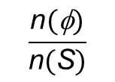
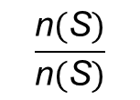
In particular,
1. if E is an impossible event, it contains no outcomes.
Then, E is an empty set,
i.e. E = φ.
∴ P(E) = P(φ) = = 0
Number of elements in φ is 0.
2. if E is an certain event, it contains all the possible outcomes.
Then, E is the same as the sample space,
i.e. E = S.
∴ P(E) = P(S) = = 1
In conclusion,
1. For an impossible event E, P(E) = 0.
2. For a certain event E, P(E) = 1.

Slide 10




A card is selected at random from a deck of
52 playing cards. Suppose X is the event of selecting a face card.
Use set notations to represent event X and find n(X).
(b) Find the probability that the card selected is a face card.
These are some examples of face cards:
…

Slide 11
A card is selected at random from a deck of
52 playing cards. Suppose X is the event of selecting a face card.
Use set notations to represent event X and find n(X).
(b) Find the probability that the card selected is a face card.
Event X = {♠J , ♠Q, ♠K, ♥J, ♥Q, ♥K , ♣J, ♣Q, ♣K, ♦J, ♦Q, ♦K }
∴ n(X)= 12
(b) P(X)
n(S) = 52

Slide 12



Follow-up question
There are 2 different red shirts, 3 different
blue shirts and 4 different white shirts in a
wardrobe. A shirt is taken at random from the
wardrobe. Suppose X is the event of taking a
red shirt or a blue shirt.
(a) Find n(S) and n(X).
(b) Hence, find the probability of taking a red shirt or a
blue shirt.
(a) n(S) =
2 + 3 + 4
= 9,
n(X) =
2 + 3
= 5
(b) P(X)

